Slide 1
CS50 Section 4
What does malloc do?
What is the argument that goes into malloc?
What does free do?
What is the argument that goes into free?

Slide 2
CS50 Section 4
What does malloc do? Allocate memory
What is the argument that goes into malloc? # of bytes
What does free do? Free bytes of memory
What is the argument that goes into free? Pointer

Slide 3
Week 4 Topics
0. Hexadecimal
1. Pointers and Addresses
2. Dynamic memory allocation
3. Reading and writing files

Slide 4
Hexadecimal
In writing, we can also indicate a value is in hexadecimal by prefixing it with 0x, as in 0x10, where the value is equal to 16 in decimal, as opposed to 10.

Slide 5
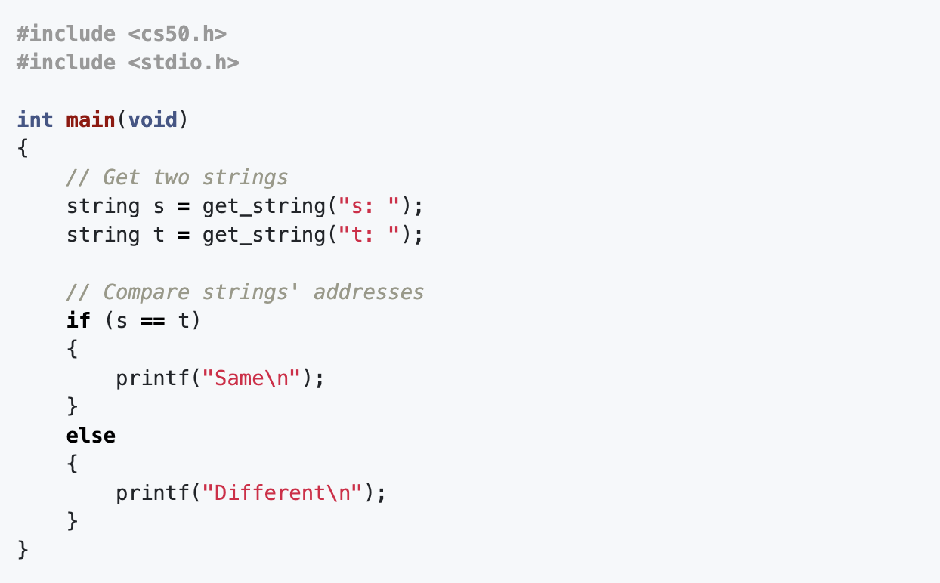
Pointers
What does this return and why?

Slide 6
Pointers
We can see the address with the & operator,
int main(void)
{
int n = 50;
printf(“%p\n”, &n);
}
What would this look like?

Slide 7
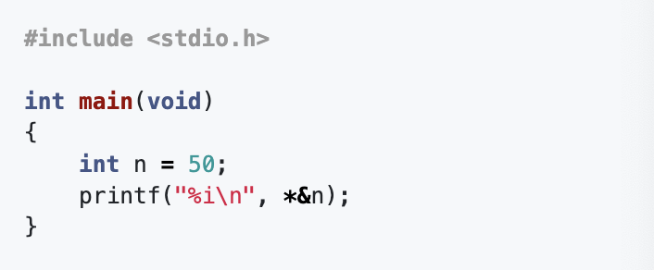
Pointers
The * operator lets us “go to” the location that a pointer is pointing to.
What does this do?

Slide 8
Pointers
How do we declare a variable that we want to be a pointer?

Slide 9
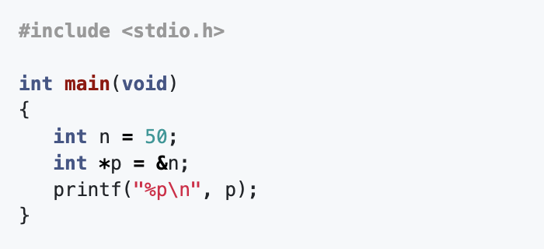
Pointers
How do we declare a variable that we want to be a pointer?
We use int *p to declare a variable, p, that has the type of *, a pointer, to a value of type int, an integer. What would this print?

Slide 10
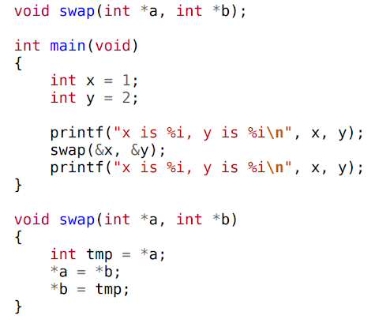
& vs. *
Use * when declaring a pointer

Slide 11
& vs. *
Use * when declaring a pointer OR accessing the value of an address / pointer

Slide 12
& vs. *
Use * when declaring a pointer OR accessing the value of an address
Use & when referencing the address of a variable or pointer

Slide 13
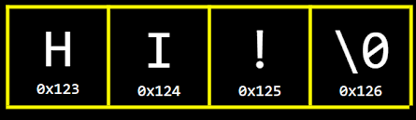
Strings
How are strings stored in memory?

Slide 14
Strings
How are strings stored in memory?
string s

Slide 15
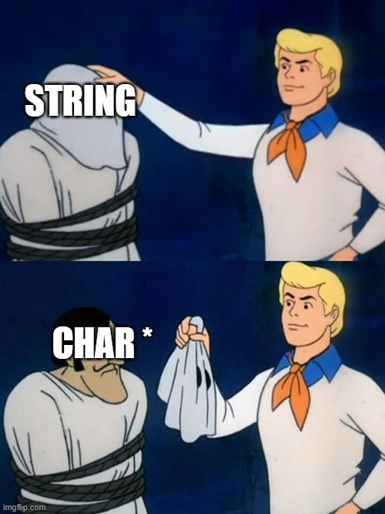
Strings
How are strings stored in memory?
char *s

Slide 16
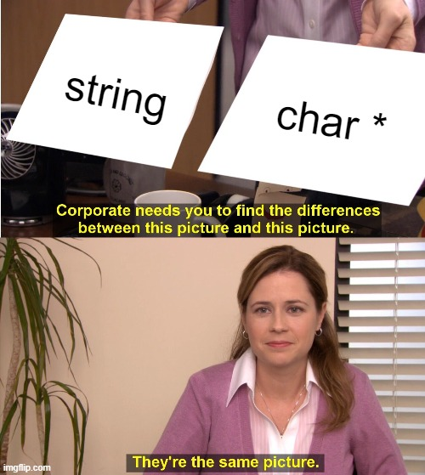
Strings and char *

Slide 17
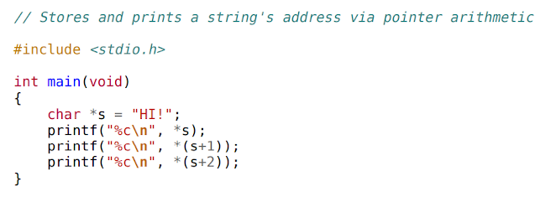
Pointer Arithmetic (Optional)

Slide 18
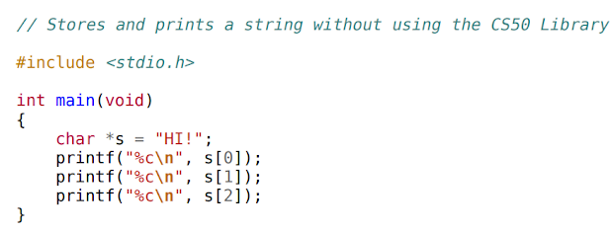
Pointer Arithmetic (Optional)

Slide 19
Pointer Arithmetic (Optional)
USE THIS!

Slide 20
Dynamic Memory Allocation

Slide 21
We know one way to use pointers -- connecting a pointer variable by pointing it at another variable that already exists in our program.

Slide 22
We know one way to use pointers -- connecting a pointer variable by pointing it at another variable that already exists in our program.
But what if we don’t know in advance how much memory we’ll need at compile time? How do we access more memory at runtime?

Slide 23
We know one way to use pointers -- connecting a pointer variable by pointing it at another variable that already exists in our program.
But what if we don’t know in advance how much memory we’ll need at compile time? How do we access more memory at runtime?
Pointers can be used to do this. Memory allocated dynamically (at runtime) comes from a pool of memory called the heap. Memory allocated at compile time typically comes from a pool of memory called the stack.
malloc

Slide 24
text
initialized data
uninitialized data
heap stack
environment variables

Slide 25
text
initialized data
uninitialized data
heap stack
environment variables

Slide 26
We get this dynamically-allocated memory via a call to the function malloc(), passing as its parameter the number of bytes we want. malloc() will return to you a pointer to that newly-allocated memory.
// Statically obtain an integer
int x;
// Dynamically obtain an integer
int *px = malloc(4);

Slide 27
We get this dynamically-allocated memory via a call to the function malloc(), passing as its parameter the number of bytes we want. malloc() will return to you a pointer to that newly-allocated memory.
If malloc() can’t give you memory (because, say, the system ran out), you get a NULL pointer.
// Statically obtain an integer
int x;
// Dynamically obtain an integer
int *px = malloc(4);

Slide 28
// Get an integer from the user
int x = get_int();
// Array of floats on the stack
float stack_array[x];
// Array of floats on the heap
float *heap_array = malloc(x * sizeof(float));

Slide 29
There’s a catch: Dynamically allocated memory is not automatically returned to the system for later use when no longer needed.
Failing to return memory back to the system when you no longer need it results in a memory leak, which compromises your system’s performance.

Slide 30
There’s a catch: Dynamically allocated memory is not automatically returned to the system for later use when no longer needed.
Failing to return memory back to the system when you no longer need it results in a memory leak, which compromises your system’s performance.
Solution: free()

Slide 31
char *word = malloc(50 * sizeof(char));
// do stuff with word
// now we’re done
free(word);

Slide 32
Rules for Free!
Every block of memory that you malloc(), you must later free().

Slide 33
Rules for Free!
Every block of memory that you malloc(), you must later free().
Only memory that you obtain with malloc() should you later free().

Slide 34
Rules for Free!
Every block of memory that you malloc(), you must later free().
Only memory that you obtain with malloc() should you later free().
Do not free() a block of memory more than once.

Slide 35
Rules for Free!
Now we will take a look at a common mistake involving pointers and free:
Freeing something you didn’t intend to free!

Slide 36
int m;

Slide 37
int m;
m

Slide 38
int m;
int *a;
m

Slide 39
int m;
int *a;
m
a

Slide 40
int m;
int *a;
int *b = malloc(sizeof(int));
m
a

Slide 41
int m;
int *a;
int *b = malloc(sizeof(int));
m
a b

Slide 42
int m;
int *a;
int *b = malloc(sizeof(int));
a = &m;
m
a b

Slide 43
int m;
int *a;
int *b = malloc(sizeof(int));
a = &m;
m
a b

Slide 44
int m;
int *a;
int *b = malloc(sizeof(int));
a = &m;
a = b;
m
a b

Slide 45
int m;
int *a;
int *b = malloc(sizeof(int));
a = &m;
a = b;
m
a b

Slide 46
int m;
int *a;
int *b = malloc(sizeof(int));
a = &m;
a = b;
m = 10;
m
a b

Slide 47
int m;
int *a;
int *b = malloc(sizeof(int));
a = &m;
a = b;
m = 10;
10
m
a b

Slide 48
int m;
int *a;
int *b = malloc(sizeof(int));
a = &m;
a = b;
m = 10;
*b = m + 2;
10
m
a b

Slide 49
int m;
int *a;
int *b = malloc(sizeof(int));
a = &m;
a = b;
m = 10;
*b = m + 2;
10
12
m
a b

Slide 50
int m;
int *a;
int *b = malloc(sizeof(int));
a = &m;
a = b;
m = 10;
*b = m + 2;
free(a);
10
12
m
a b

Slide 51
int m;
int *a;
int *b = malloc(sizeof(int));
a = &m;
a = b;
m = 10;
*b = m + 2;
free(a);
10
m
a b

Slide 52
int m;
int *a;
int *b = malloc(sizeof(int));
a = &m;
a = b;
m = 10;
*b = m + 2;
free(a);
*b = 11;
10
m
a b

Slide 53
int m;
int *a;
int *b = malloc(sizeof(int));
a = &m;
a = b;
m = 10;
*b = m + 2;
free(a);
*b = 11;
10
m
a b

Slide 54
What happens if we do not free memory that we have allocated?

Slide 55
What happens if we do not free memory that we have allocated?
Memory leak: Can run out of dynamic memory
Make sure to run valgrind on your code to ensure you don’t have any memory leaks.

Slide 56
What happens if we do not free memory that we have allocated?
Memory leak: Can run out of dynamic memory
Make sure to run valgrind on your code to ensure you don’t have any memory leaks.
What happens if we malloc too many times?

Slide 57
What happens if we do not free memory that we have allocated?
Memory leak: Can run out of dynamic memory
Make sure to run valgrind on your code to ensure you don’t have any memory leaks.
What happens if we malloc too many times?
Similarly, run out memory, heap overflow

Slide 58
What happens if we do not free memory that we have allocated?
Memory leak: Can run out of dynamic memory
Make sure to run valgrind on your code to ensure you don’t have any memory leaks.
What happens if we malloc too many times?
Similarly, run out memory, heap overflow
What happens if we call functions too many times?

Slide 59
What happens if we do not free memory that we have allocated?
Memory leak: Can run out of dynamic memory
Make sure to run valgrind on your code to ensure you don’t have any memory leaks.
What happens if we malloc too many times?
Similarly, run out memory, heap overflow
What happens if we call functions too many times?
Stack overflow

Slide 60
Practice Problem 1: Concatenate
Write a function concatenate that takes two strings and returns a concatenated version of the two strings.
Use the following code to test your function:
int main(void)
{
char *s1 = get_string("s1: ");
char *s2 = get_string("s2: ");
char *s3 = concatenate(s1, s2);
printf("%s\n", s3);
free(s3);
}

Slide 61
File I/O

Slide 62
The ability to read data from and write data to files is the primary means of storing persistent data, which exists outside of your program.

Slide 63
The ability to read data from and write data to files is the primary means of storing persistent data, which exists outside of your program.
In C, files are abstracted using a data structure called a FILE. Almost universally, though, when working with FILEs do we actually use pointers to files (aka FILE *).

Slide 64
The functions we use to manipulate files all are found in stdio.h.

Slide 65
The functions we use to manipulate files all are found in stdio.h.
Every one of them accepts a FILE * as one of its parameters, except fopen() which is used to get a file pointer in the first place.

Slide 66
The functions we use to manipulate files all are found in stdio.h.
Every one of them accepts a FILE * as one of its parameters, except fopen() which is used to get a file pointer in the first place.
Some of the most common file input/output (I/O) functions we’ll use are the following:
fopen() | fclose() | fgetc() | fputc() | fread() | fwrite()

Slide 67
fopen() opens a file and returns a pointer to it. Always check its return value to make sure you don’t get back NULL.
FILE *ptr = fopen(<filename>, <operation>);

Slide 68
fopen() opens a file and returns a pointer to it. Always check its return value to make sure you don’t get back NULL.
FILE *ptr = fopen("test.txt", "r");
FILE *ptr2 = fopen("test2.txt", "w");
FILE *ptr3 = fopen("test3.txt", "a");

Slide 69
fgetc() reads and returns the next character from the file, assuming the operation for that file contains "r". fputc() writes or appends the specified character to the file, assuming the operation for that pointer contains "w" or "a".
fgetc(<file pointer>);
fputc(<character>, <file pointer>);

Slide 70
fgetc() reads and returns the next character from the file, assuming the operation for that file contains "r". fputc() writes or appends the specified character to the file, assuming the operation for that pointer contains "w" or "a".
char c = fgetc(ptr1);
fputc('x', ptr2);
fputc('5', ptr3);

Slide 71
fread() and fwrite() are analogs to fgetc() and fputc(), but for a generalized quantity (qty) of blocks of an arbitrary (size), holding those blocks in (or writing them from) a temporary buffer, usually an array, for local use within the program.
fread(<buffer>, <size>, <qty>, <file pointer>);
fwrite(<buffer>, <size>, <qty>, <file pointer>);

Slide 72
fread() and fwrite() are analogs to fgetc() and fputc(), but for a generalized quantity (qty) of blocks of an arbitrary (size), holding those blocks in (or writing them from) a temporary buffer, usually an array, for local use within the program.
int arr[10];
fread(arr, sizeof(int), 10, ptr);
fwrite(arr, sizeof(int), 10, ptr2);

Slide 73
fclose() closes a previously opened file pointer.
fclose(<file pointer>);

Slide 74
fclose() closes a previously opened file pointer.
fclose(ptr);
fclose(ptr2);
fclose(ptr3);

Slide 75
Lots of other useful functions abound in stdio.h for you to work with. Here are some you might find useful.
fgets() | Reads a full string from a file.
fputs() | Writes a full string to a file.
fprintf() | Writes a formatted string to a file.
fseek() | Allows you to rewind or fast-forward within a file.
ftell() | Tells you at what (byte) position you are at within a file.
feof() | Tells you whether you’ve read to the end of a file.
ferror() | Indicates whether an error has occurred in working with a file.

Slide 76
Lots of other useful functions abound in stdio.h for you to work with. Here are some you might find useful.
IMPORTANT: To detect if the character you are reading is the end of the file, use EOF
fgets() | Reads a full string from a file.
fputs() | Writes a full string to a file.
fprintf() | Writes a formatted string to a file.
fseek() | Allows you to rewind or fast-forward within a file.
ftell() | Tells you at what (byte) position you are at within a file.
feof() | Tells you whether you’ve read to the end of a file.
ferror() | Indicates whether an error has occurred in working with a file.

Slide 77
Tips and Common Mistakes for Reading/Writing an Entire File
Tips
Use a loop to read files “chunk by chunk”
Keep looping until you reach the end of the file or the stopping condition
Declare temporary buffer variables to store the bytes that you read if needed
You can then write the information from that temporary variable to a file

Slide 78
Tips and Common Mistakes for Reading/Writing an Entire File
Mistakes
Forgetting to close a file after opening it and performing actions on it
Forgetting to open a file with an additional parameter “a”, “w”, or “r”
Forgetting to check if a file you opened is NULL
Forgetting to exit reading/writing loop with if (c == EOF), break

Slide 79
Practice Problem 2: Copy File
In a file copy.c, write a program that copies a text file. Users should be able to run ./copy file1 file2 to copy the contents of text file file1 into file file2.

Slide 80
Practice Problem 3: GIF Detection
Write a program gif.c that checks if a file (likely) a GIF (specifically, a GIF 89a file, the latest version of the GIF file format). Note that the first six characters of a GIF 89a file are the characters G, I, F, 8, 9, a.

Slide 81
Lab: Volume of WAV Files
https://cs50.harvard.edu/college/2020/fall/labs/4/

